Slide 1
Jessica’s wildlife file

Slide 2
Trees (Found in my garden)

Slide 3
Corkscrew Hazel
Hazel is a deciduous broadleaf tree native to the UK.

Slide 4
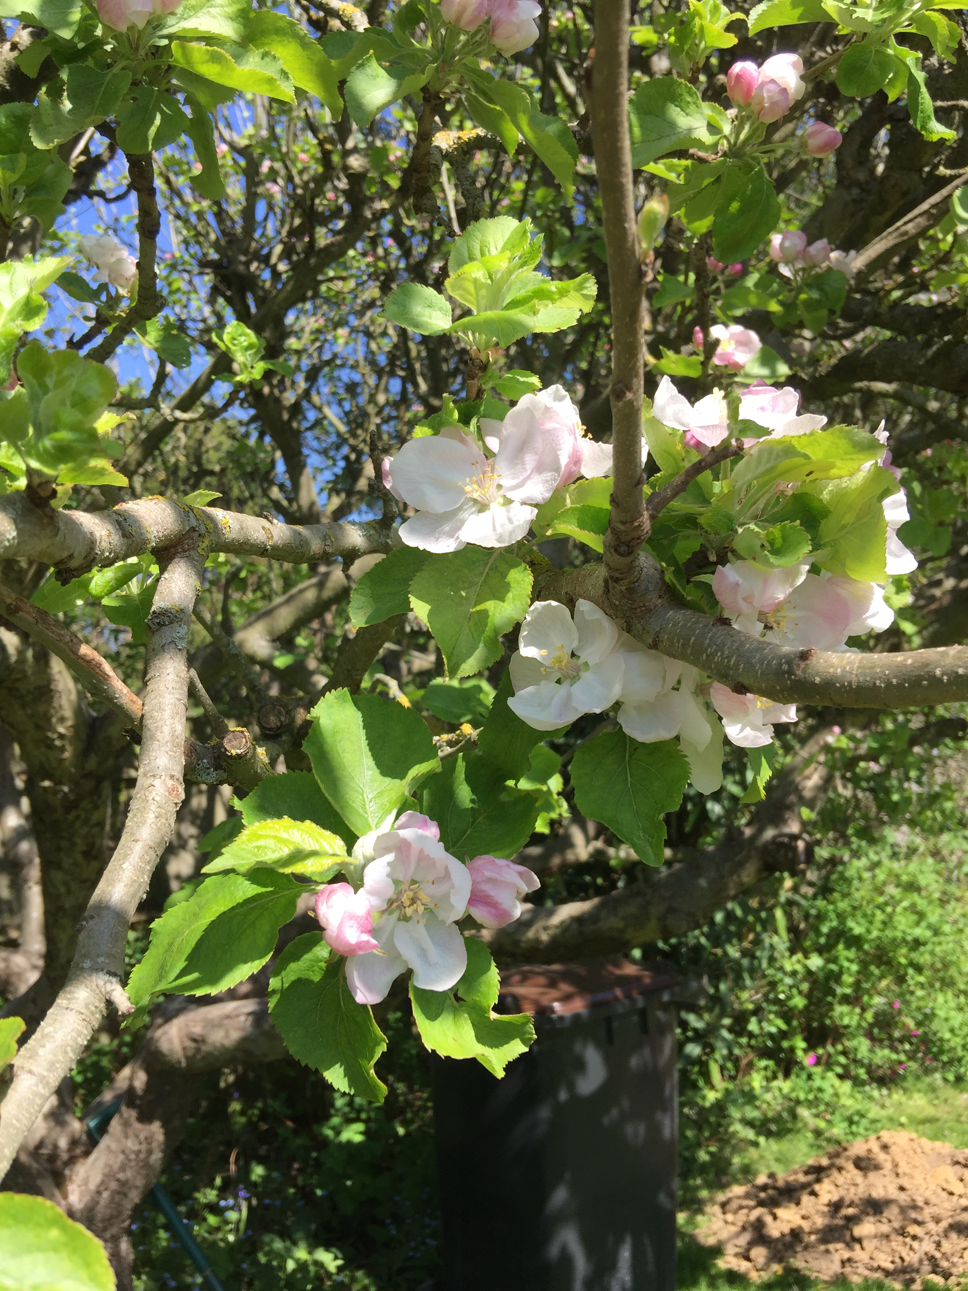
Apple
Apple is a deciduous tree which is grown worldwide for its fruits, the are over 7500 cultivated varieties.

Slide 5
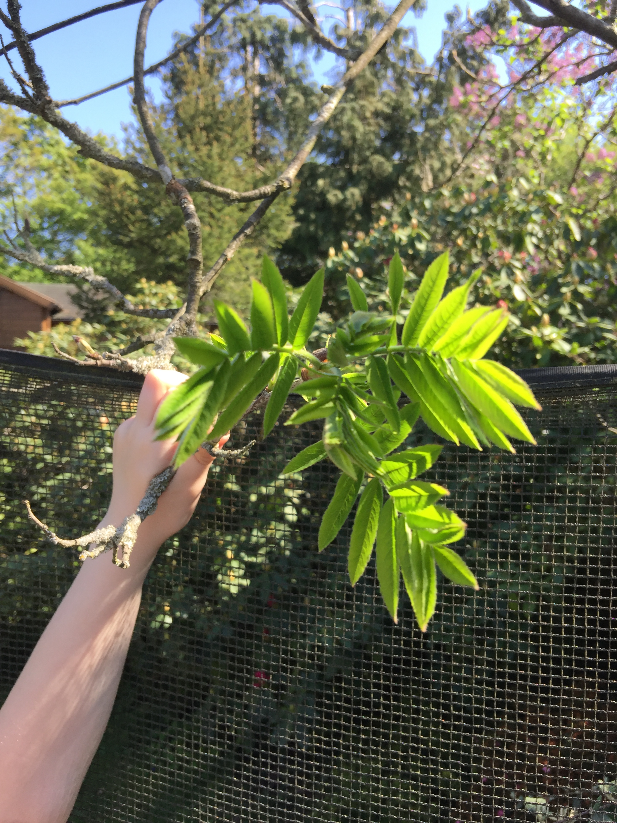
Rowan
Rowan is also known as mountain ash and is native to the UK and northern and western Europe.

Slide 6
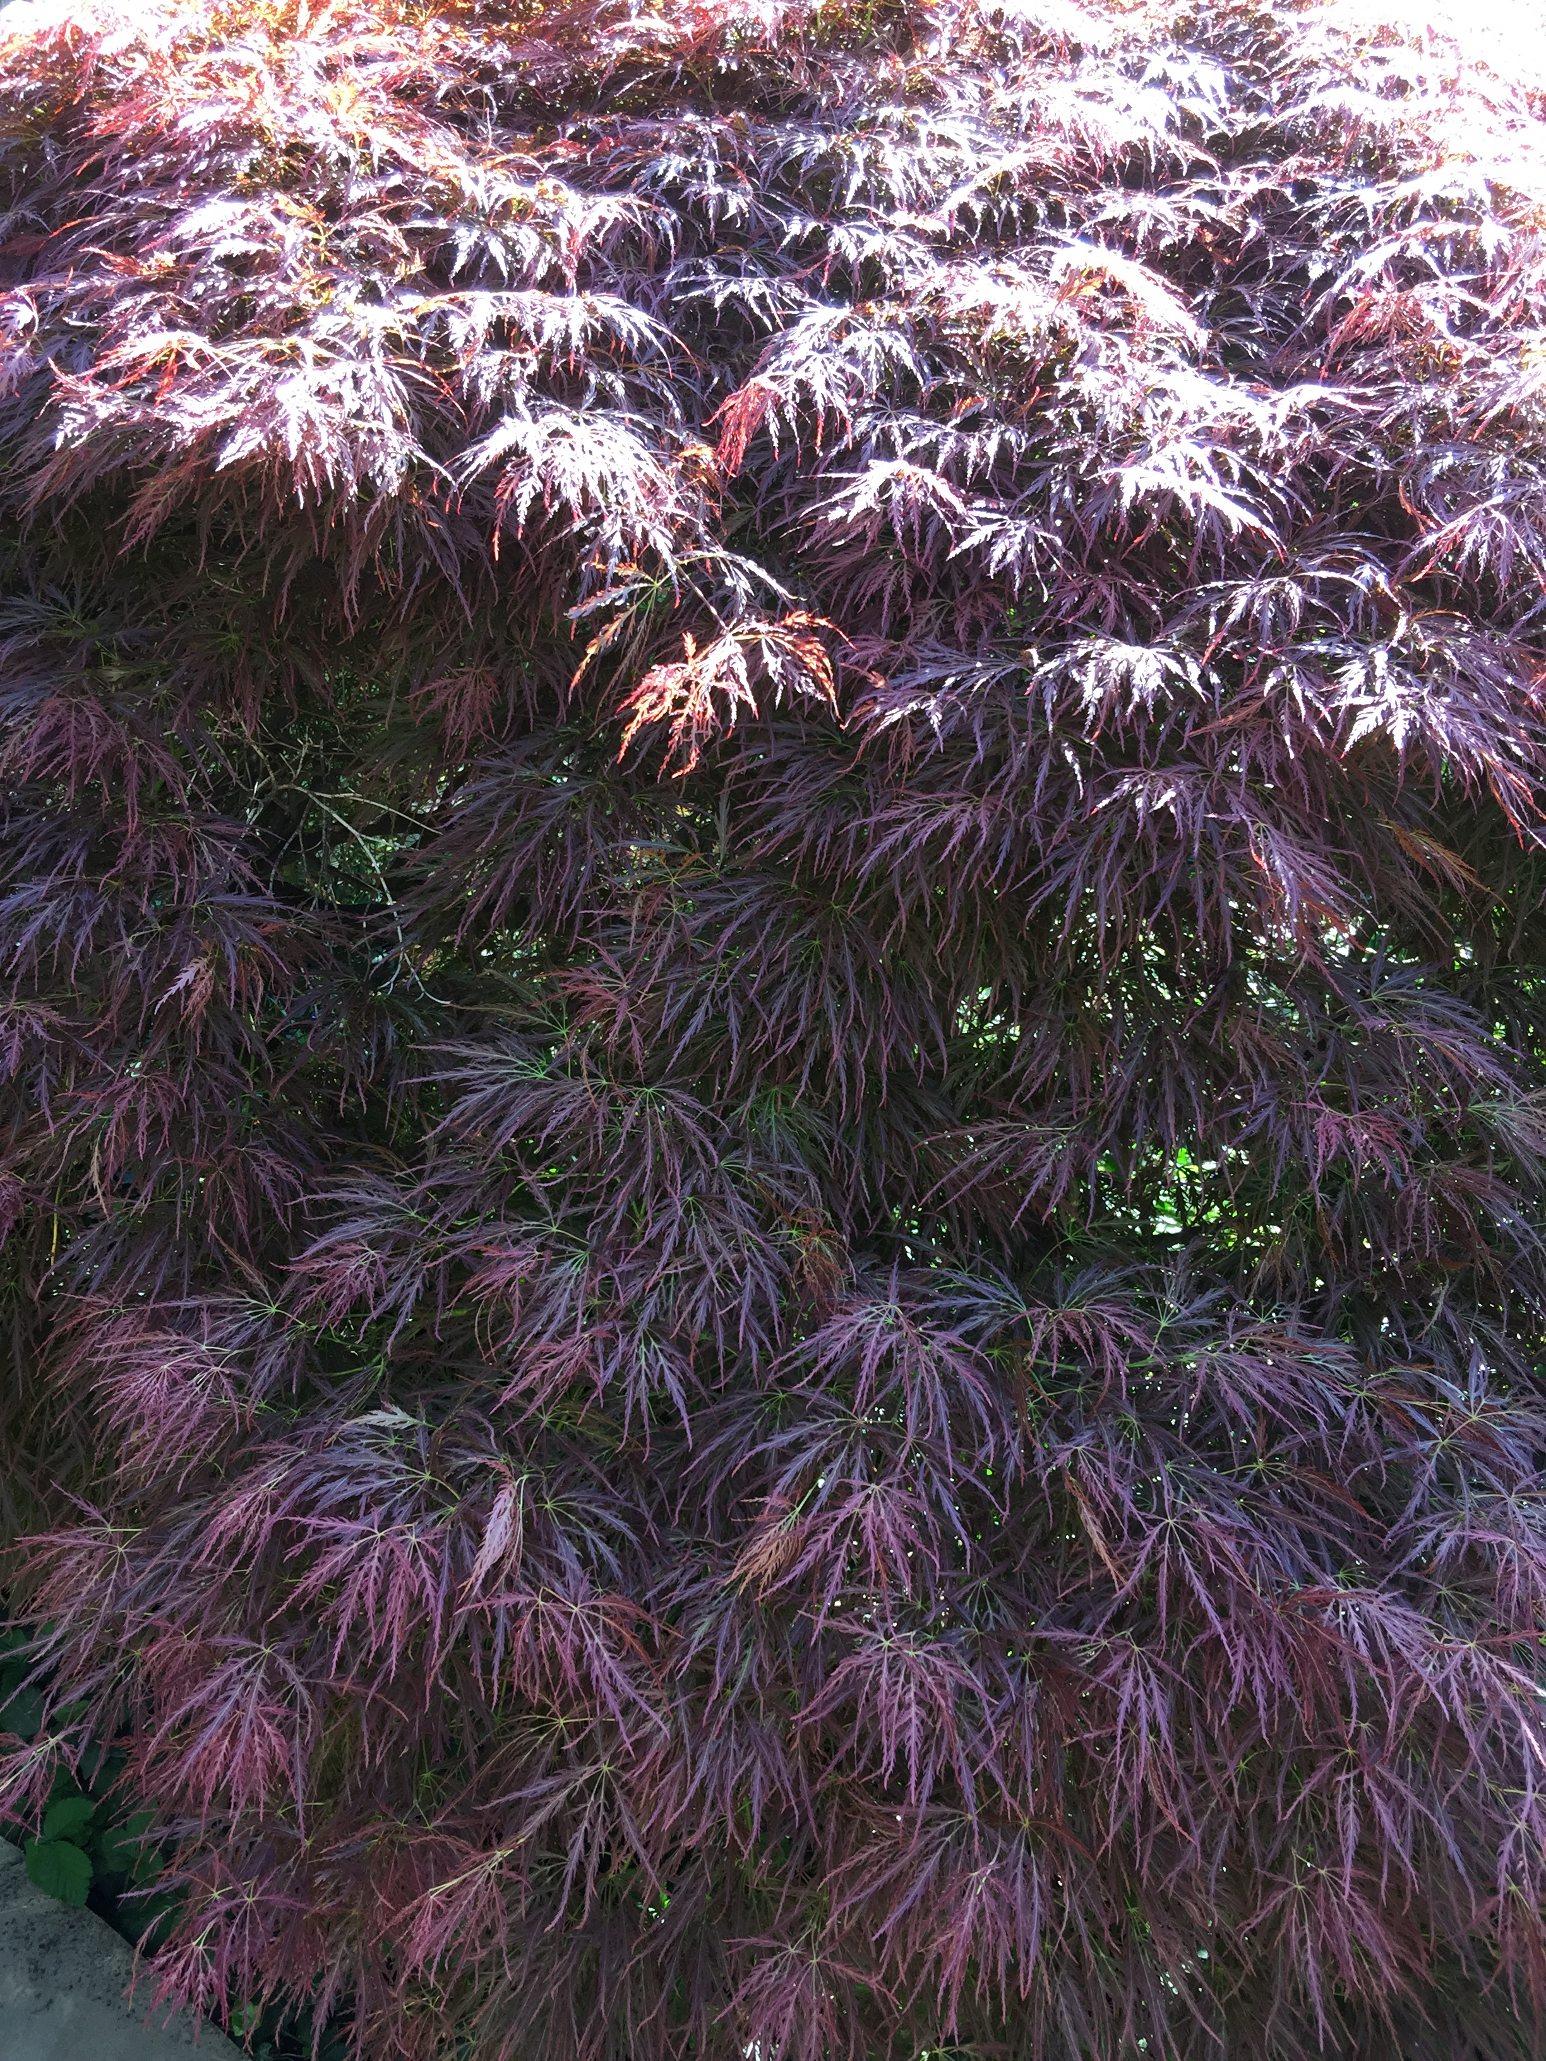
Japanese Maple / Acer
It is a deciduous tree. It has beautiful bright red foliage in the spring which turn crimson red in the autumn.

Slide 7
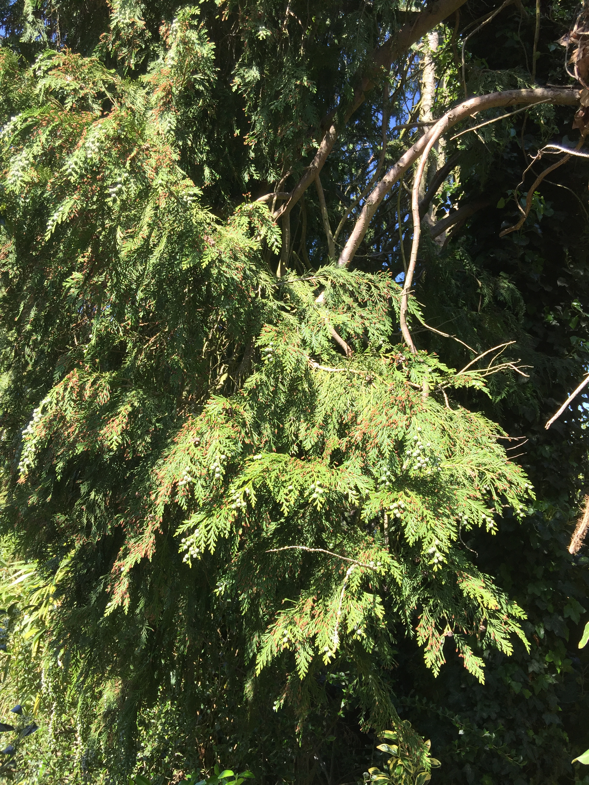
Leyland Cypress
Leyland cypress is a sterile cross between the Monterey cypress and the Nootka cypress (both North American species.

Slide 8
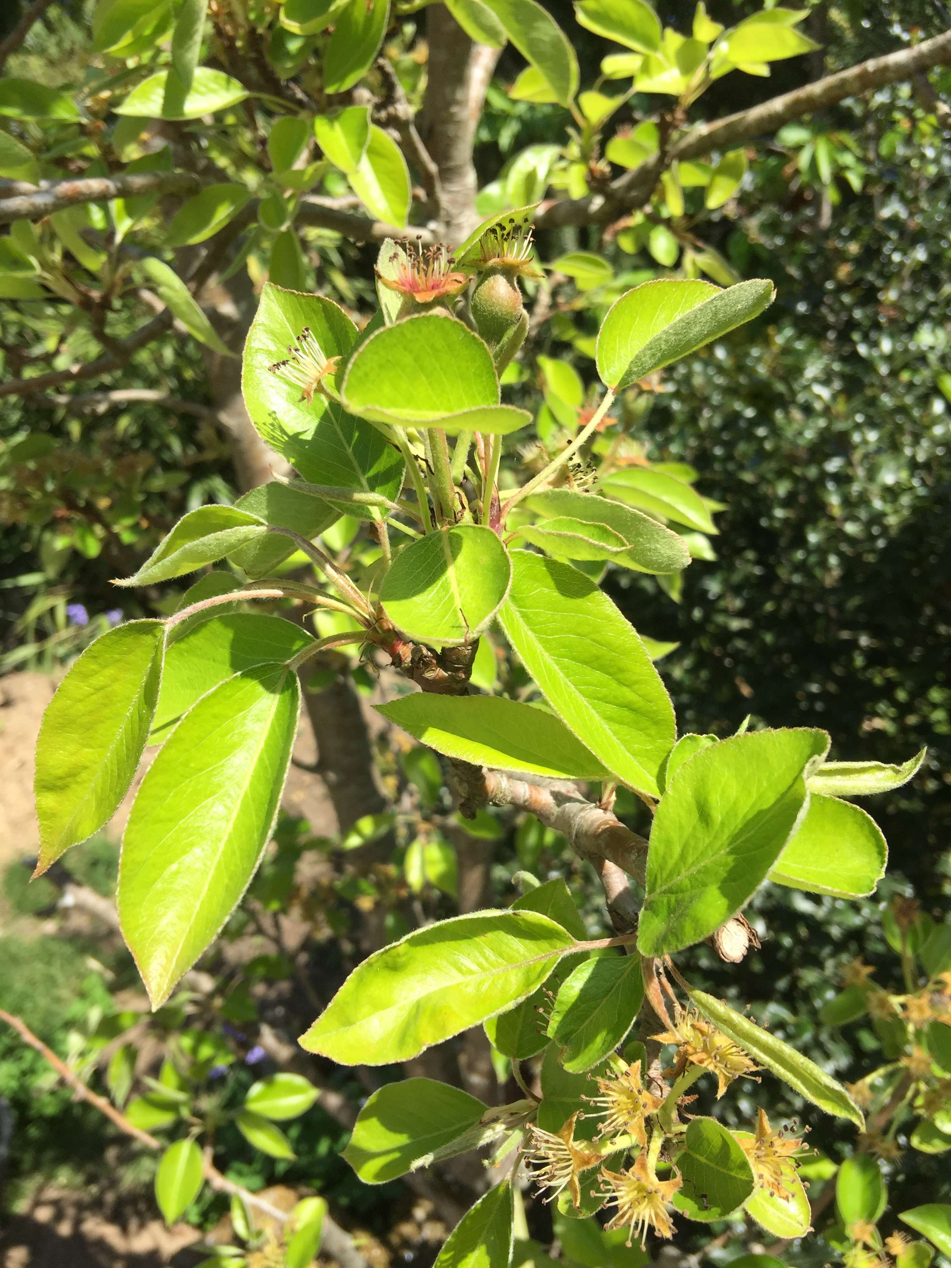
Williams pear
It is a deciduous which produces pears in the summer.

Slide 9
Flowers (Found in my garden)

Slide 10
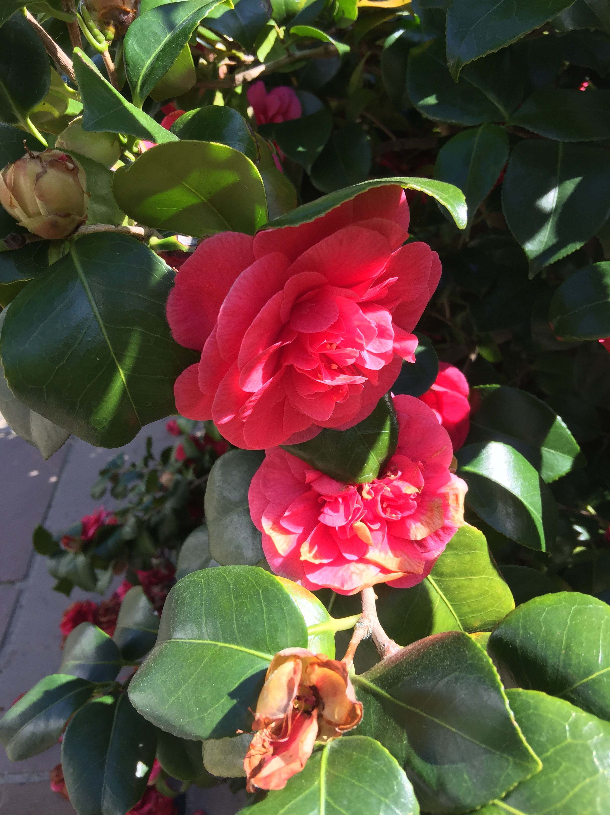
Camellia

Slide 11
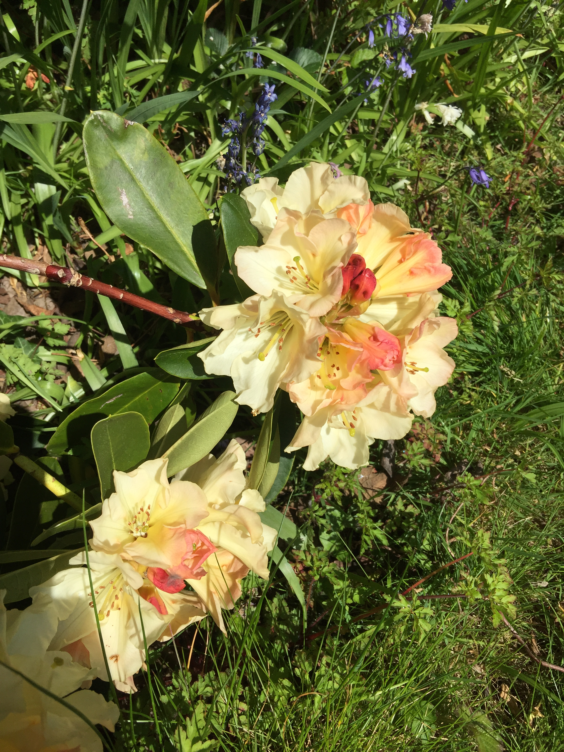
Rhododendron

Slide 12
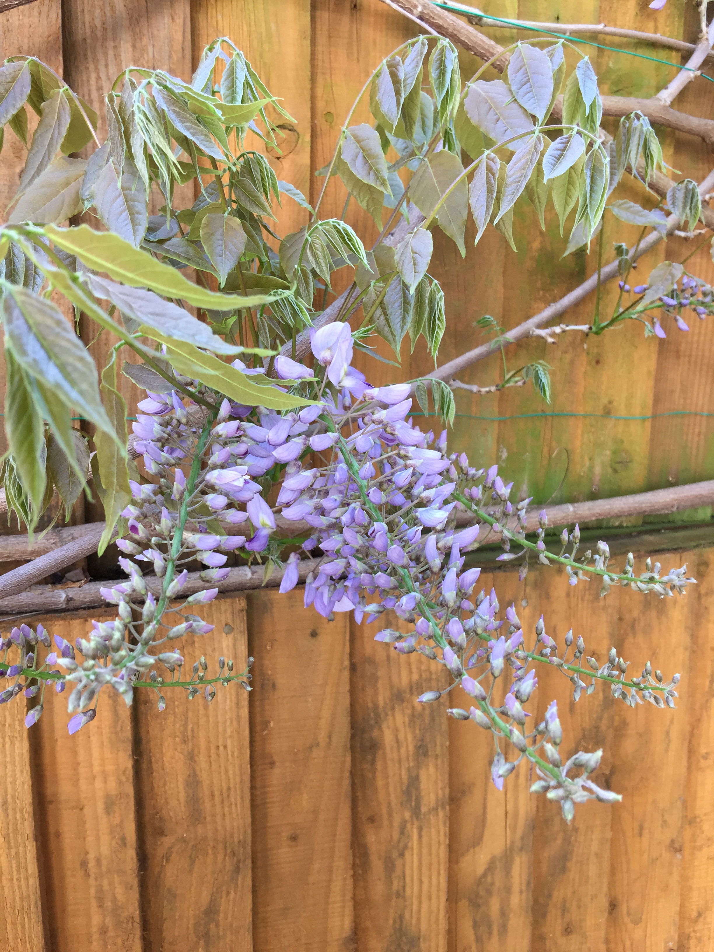
Wisteria

Slide 13
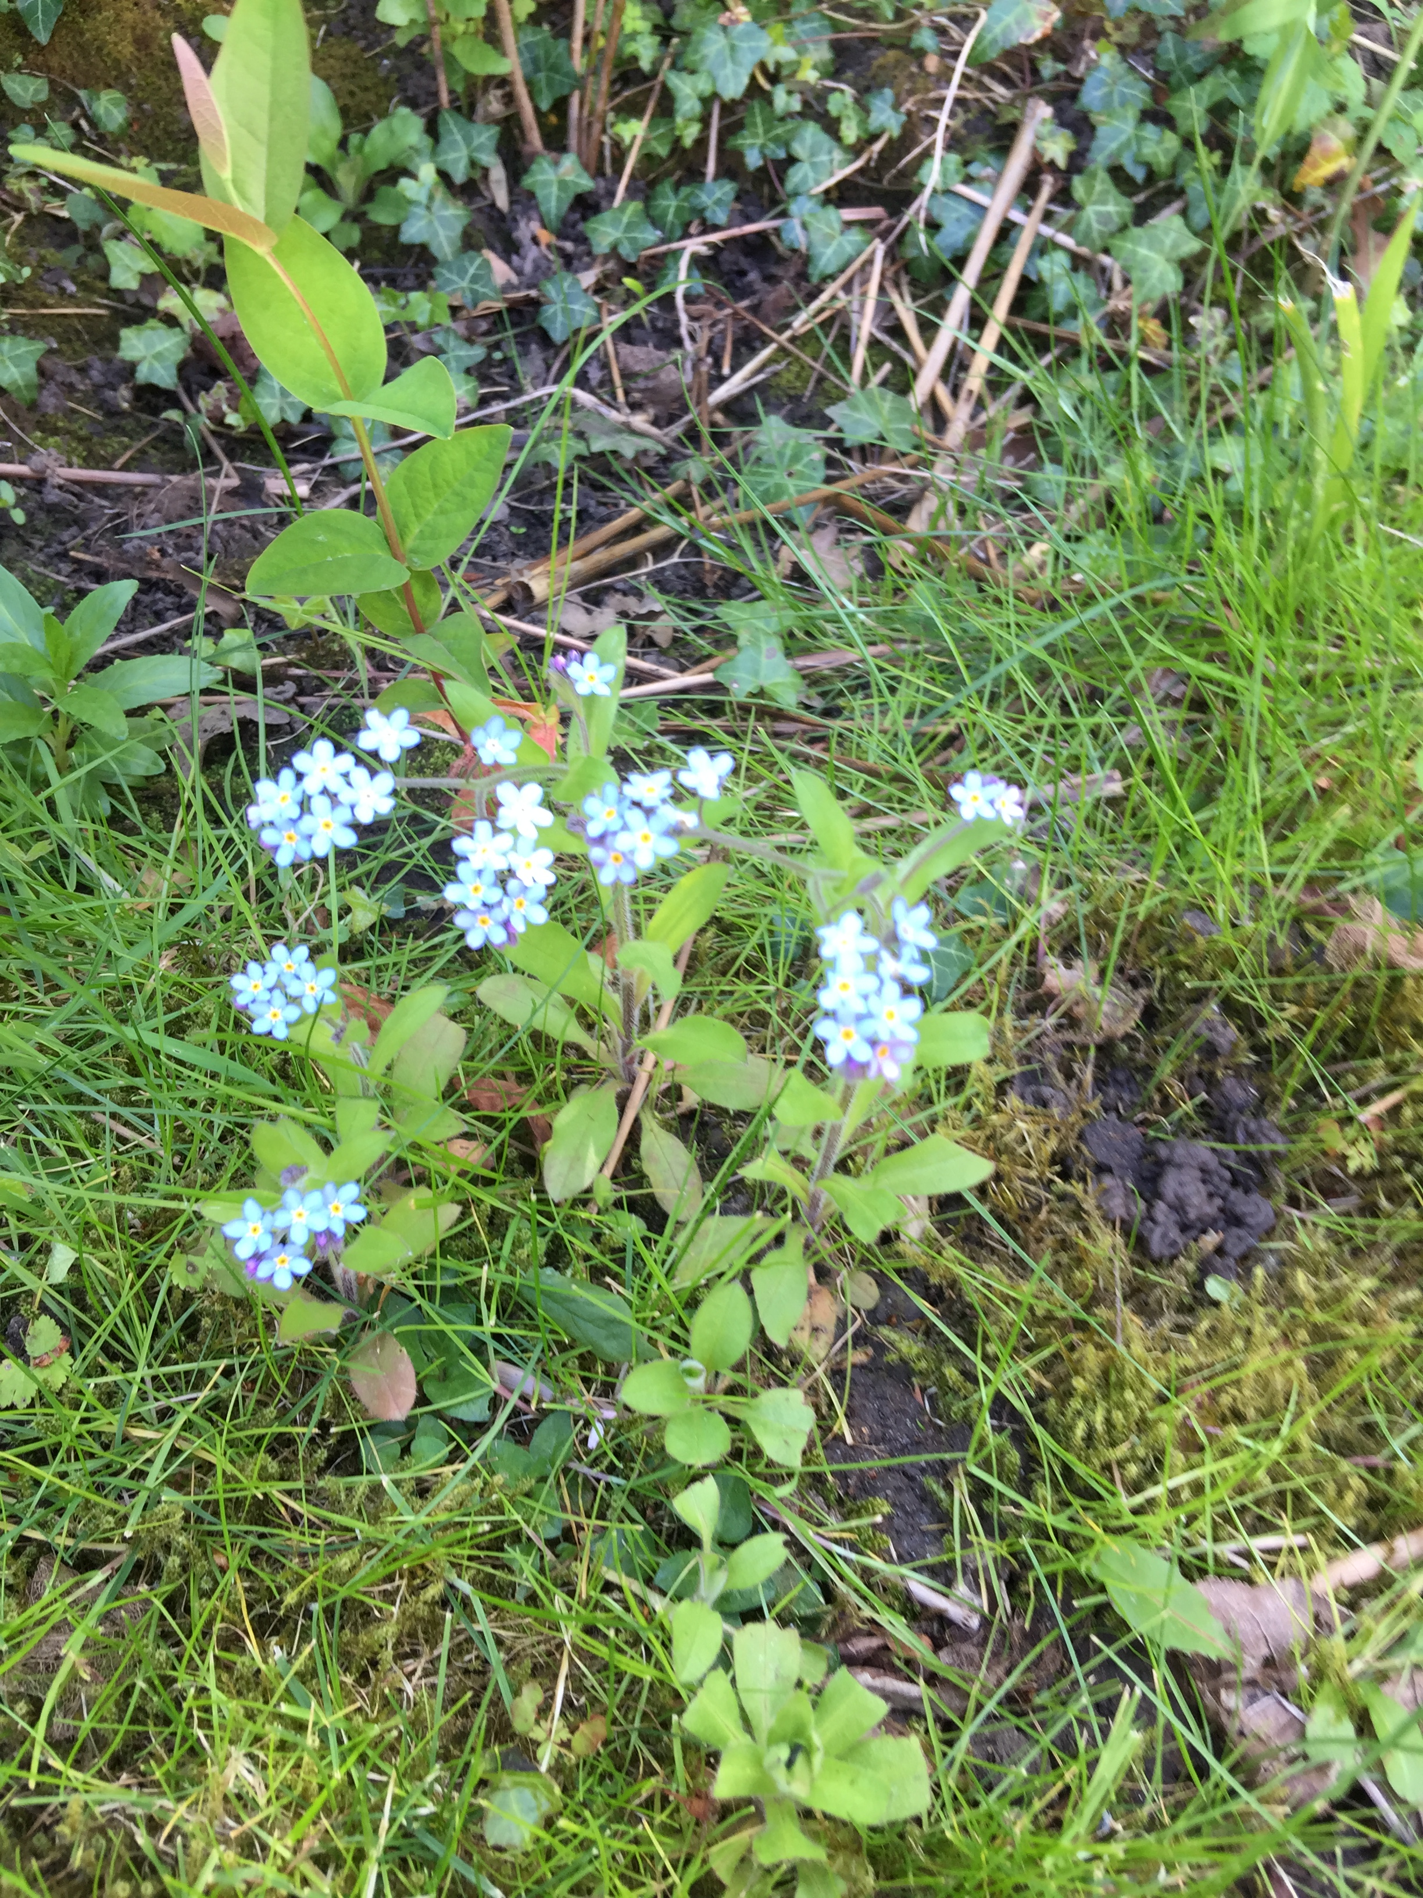
Forget-me-nots

Slide 14
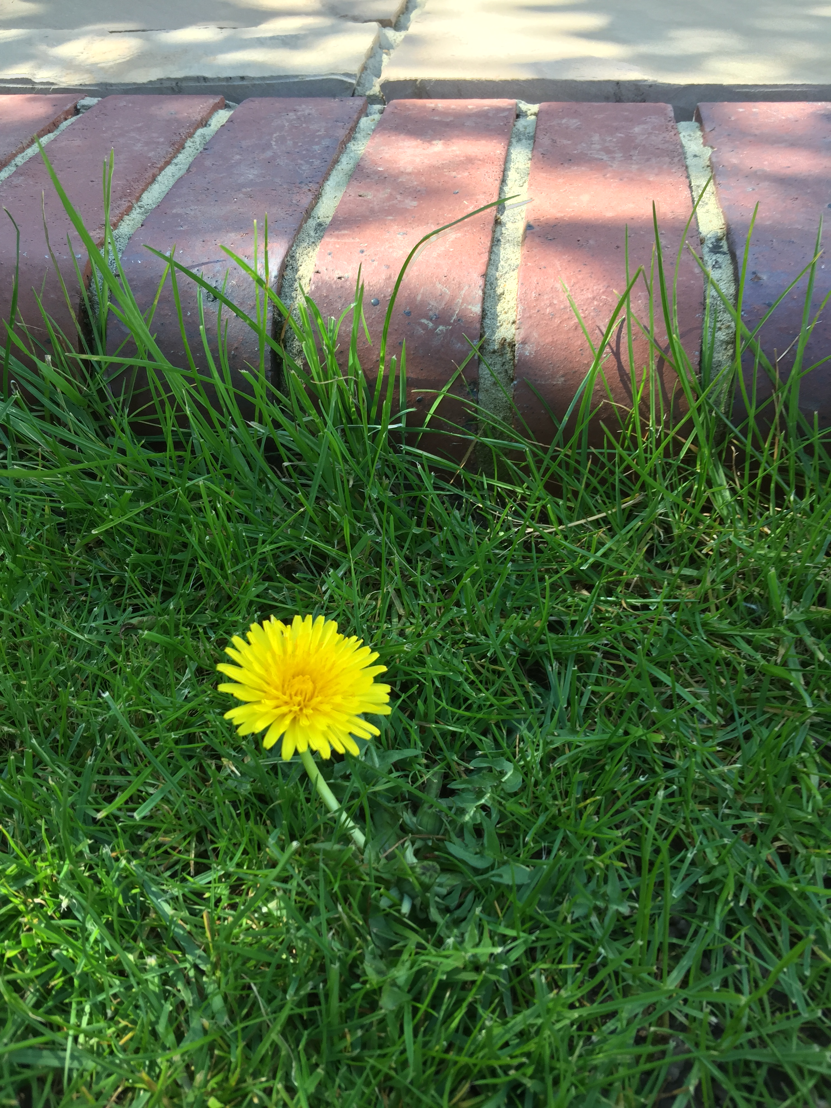
Dandelion

Slide 15
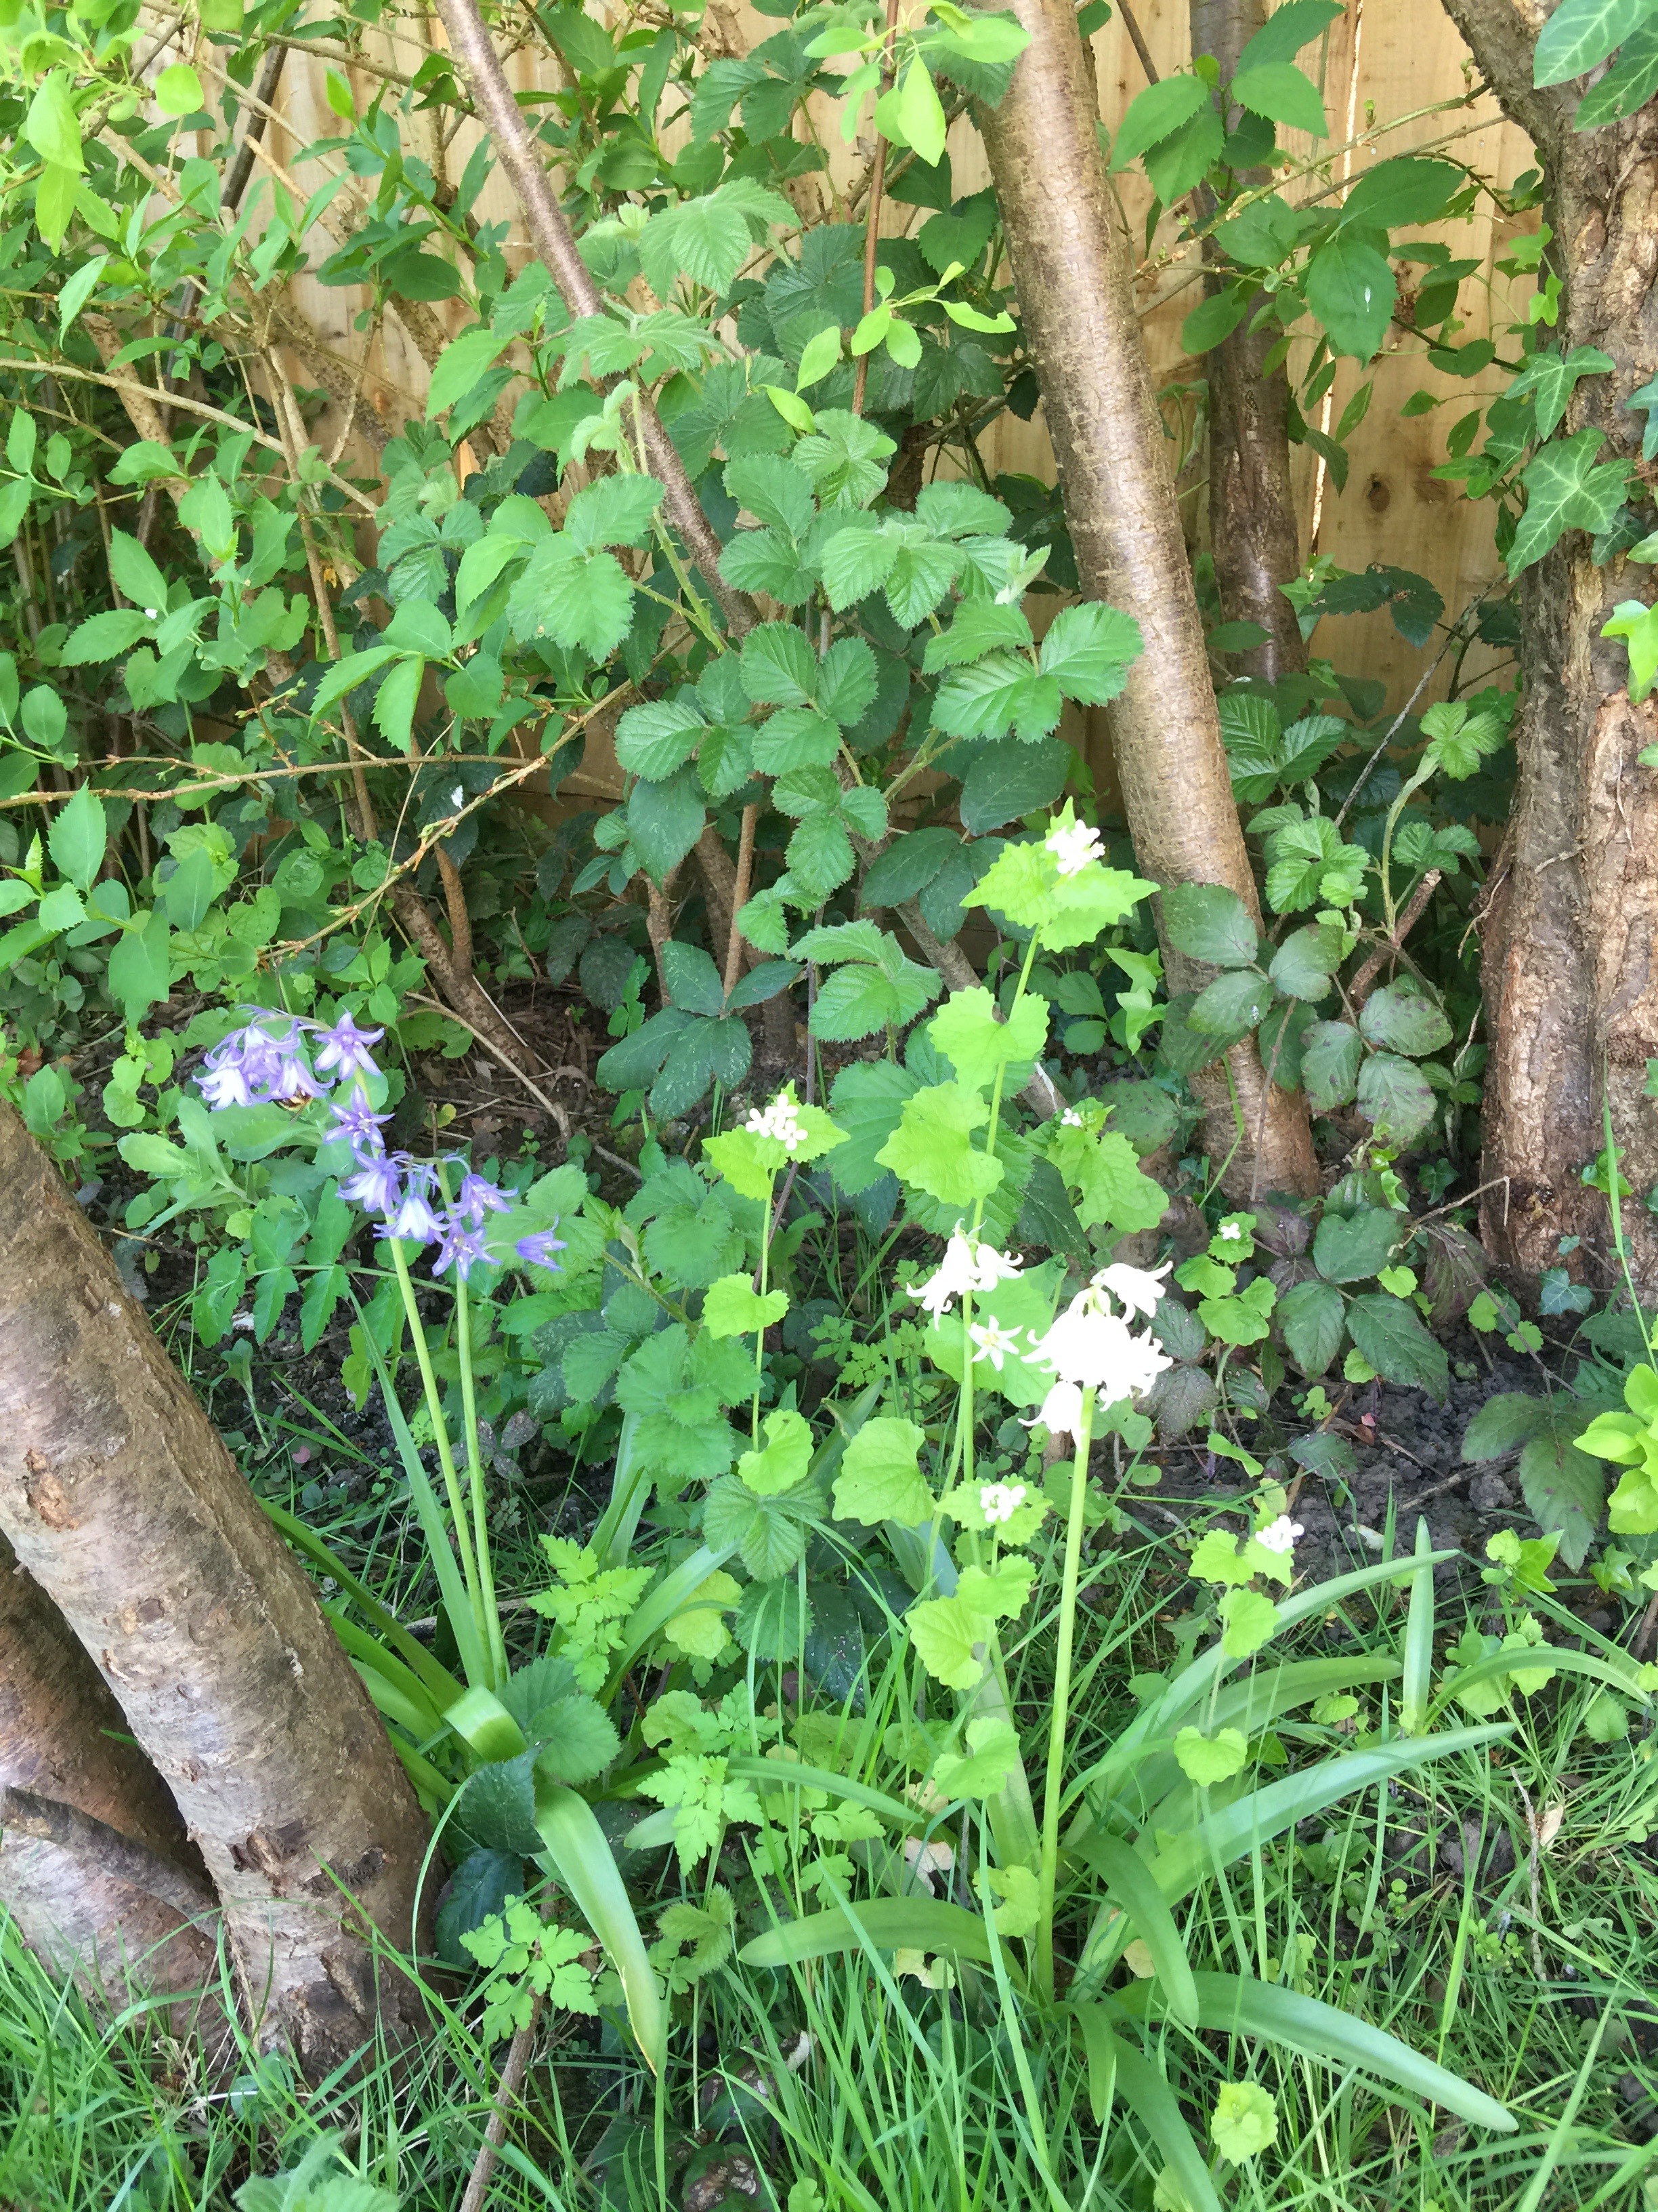
Bluebell (blue and white ones)

Slide 16
British Birds

Slide 17
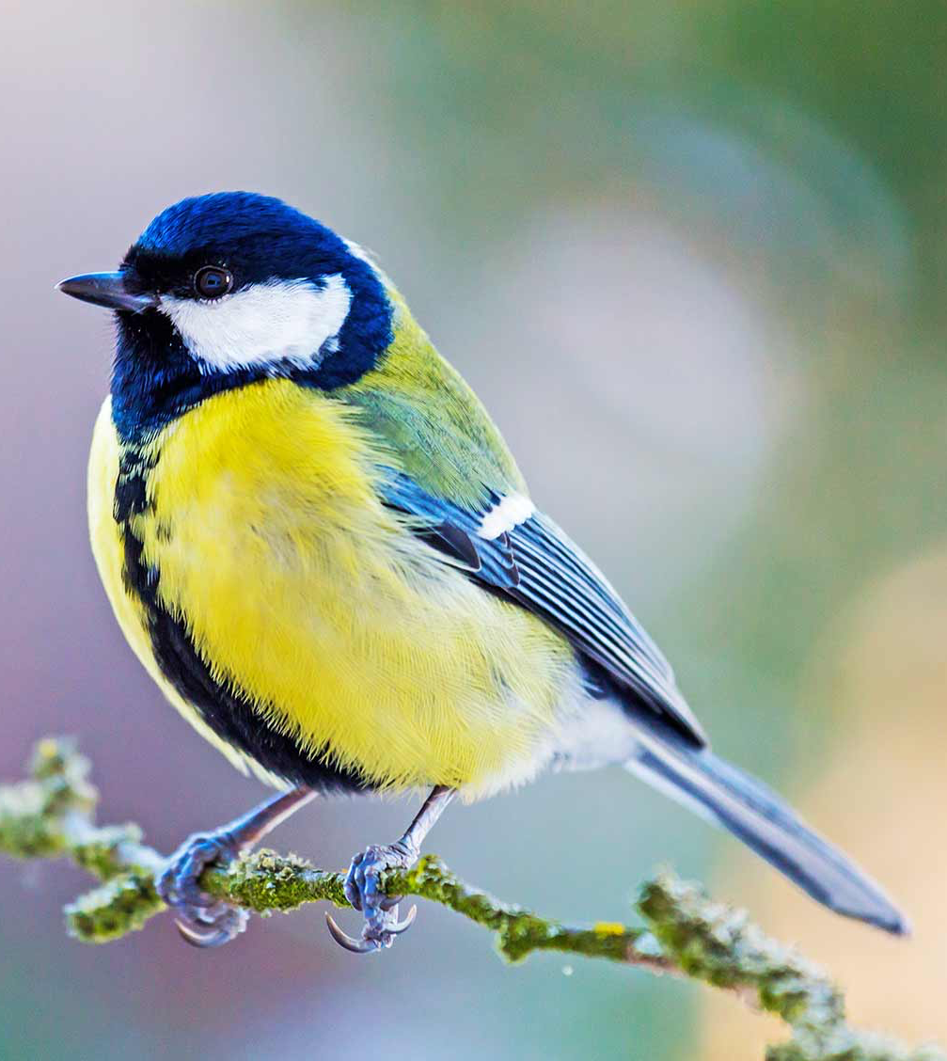
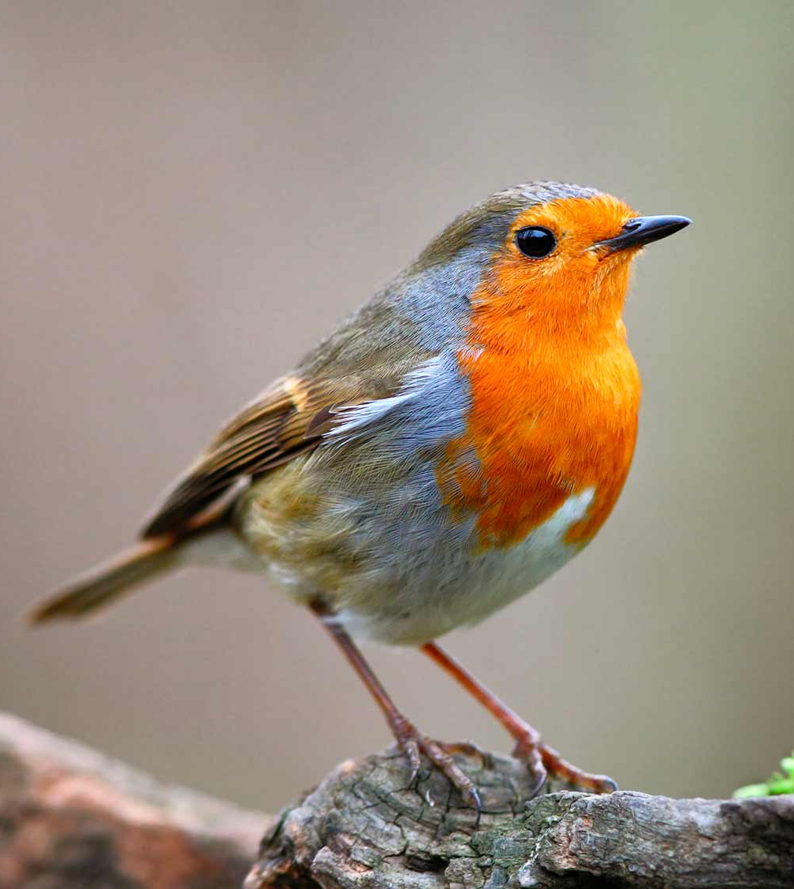
Eurasian blue tit and European robin

Slide 18
Great tit and House sparrow

Slide 19
Coal tit and Lesser spotted woodpecker

Slide 20
Websites Used
www.Google.co.uk
www.woodlandtrust.org.uk
www.mywildflowers.com
www.rspb.org.uk

